Slide 1
Introduction to LaTeX
Chris Cooling
ECRI Senior Teaching Fellow

Slide 2
Important Information on Marking your Attendance on Inkpath
I will show you a QR code at the end of the session allowing you to mark your attendance on Inkpath. Please do not mark your attendance until then. If you are a Postgraduate Research student, this is required for receiving your ECRI professional development credit for this course.

Slide 3
Learning Outcomes
Recognise the advantages of LaTeX and its applications in the wider context of typesetting
Identify the key features for reading and compiling an existing .tex document
Develop new technical documents from simple templates
Create simple equations, figures, tables, lists and references within LaTeX
Assess and troubleshoot common compiler problems and use online aid tools

Slide 4
Using this PowerPoint
Further notes and comments in the notes section of most slides
Annotates and explains the examples
Notes also often contain links to Overleaf projects used to generate examples
Allows you to see the example in the context of a compete project

Slide 5
What is LaTeX?
Typesetting tool
In some ways, similar to a programming language
Developed in mid-1980s
Still actively supported and developed
Very popular in technical and academic
Notes:
LaTeX is a powerful and versatile typesetting tool. It’s exceptionally well-suited to the production of high-quality technical reports including journal articles and theses. It provides advanced tools to include and customise equations, figures, references, bibliographies including the automation of many tasks. In addition, many optional packages exist to provide specialist functionality. And if something suiting you doesn’t exist, you can create it yourself. In some ways it is like a programming language – you edit an input file and pass it to a program (the LaTeX compiler) to tell it what to do. In the case of LaTeX, this is producing a final document.

Slide 6
How do I Use LaTeX?
Edit input files
Run the compiler to produce a .pdf output
Can edit files in many places
Can use many interfaces to run the compiler
Auxiliary Files
.aux
.bbl
.out
.gls
…
.tex
Input Files
.bib
.cls
LaTeX Compiler
.pdf
.bst
Image Files
Packages
Notes:
When producing a LaTeX document, you will edit a family of input files. The most important of these is are files ending in .tex. These files are where you describe the content and formatting of your document. Files ending in .bib contain information that will used to populate your bibliography. You will also need to provide files containing images you want to be included in your document. There are other input files that can be used, but these are more advanced, and you don’t need to worry about them yet.
These files are read by a program known as a “LaTeX compiler” which interprets the instructions and produces an output file, typically a pdf. While doing this LaTeX will often create several auxiliary files which it uses to keep track of various types of data while constructing the pdf. In some interfaces these files will be hidden and most of the time you don’t need to worry about these files, but you shouldn’t be surprised if you see them.
LaTeX is a very modular language and there are many packages that have been developed by users that can be installed on your computer to allow your LaTeX compiler to use them. These packages typically introduce some extra functionality which allows you to create a new effect or use a new workflow in your document. It’s not uncommon to use a few dozen packages in a large project.
As most LaTeX input files are plain text files, you can edit them in several places. You can use a simple text editor, an IDE such as Visual Studio Code, or a bespoke LaTeX editor. LaTeX was originally designed to run on the command line, and you can still run a LaTeX compiler there, but it’s common to use built in visual interfaces in IDEs or LaTeX editors, which makes the interface easier to work with.

Slide 7
What are the Advantages and Disadvantages of LaTeX?
Advantage | Disadvantage
Excellent technical typesetting | Has a steeper learning curve
Easy to edit document-wide settings | Is not “what you see is what you get”
Very versatile | Doing simple things is harder
Easy to iterate images | Overwhelming variety of ways to do things
Makes doing some complicated things easy | Not underpinned by broader systems
Input files are stored in plain text | Collaboration more difficult
Free | Less widely used
Portable
Stable
Can produce a wide range of document types
Large knowledge base
Notes:
When deciding which tool to use to produce a technical document, your two main choices are LaTeX and Microsoft Word. When comparing the two, LaTeX has some advantages and some disadvantages.
Advantages:
LaTeX can produce precise, clear and good-looking technical documents.
Because LaTeX documents are produced programmatically each time the document is compiled, it’s easy to change how the whole document looks by editing a few settings.
LaTeX can produce a wide range of constructs, and style them in a wide variety of ways.
Because LaTeX inserts images from image file each time the document is recompiled, replacing an image only requires replacing the image file and recompiling the document – you don’t need to redo any formatting. This is normally a very quick and easy task.
The existence of custom packages and commands can allow some complicated things to be accomplished very easily.
LaTeX input files are plain text files, so can be edited in many programs, are easy to store, and are unlikely to get corrupted or outdated.
LaTeX is free and easily available.
LaTeX can easily be installed on all common operating systems or used in online tools.
LaTeX is stable and doesn’t change much year-on-year. If you have a set of LaTeX files from ten years ago, it is likely that it will compile today with no problem. The output pdf files are also very stable and portable.
LaTeX can be used to produce all sorts of documents, including slides and posters.
LaTeX has a large user community. Because LaTeX is stable and long-lasting, if you find a guide, blog post, or question on a forum written ten years, it will probably still be accurate today.
Disadvantages
LaTeX has a steeper learning curve than Microsoft Word. Producing a skeleton of a document takes some basic knowledge.
The files you edit in LaTeX are not the final outputs. So, it’s not possible to drag an image to the right or something similar. It’s common to have the input file and the pdf open next to each other to mitigate this disconnect.
Because options are selected through specifying them in text rather than using a user interface, it requires the user to know more to achieve simple effects.
There can be several ways to do the same thing in LaTeX (such as different packages that do the same thing) and knowing which to use is not always straightforward.
A Program like Microsoft Word is integrated into the Microsoft ecosystem, making it easy to store and collaboratively edit documents. LaTeX doesn’t have comparable capability.
Collaboration can be more difficult, often requiring setups more commonly seen in software engineering.
LaTeX is less widely used – you can guarantee your supervisor or collaborator will know LaTeX.

Slide 8
LaTeX and Microsoft Word
Both use entirely different approaches to encode content and formatting
Very difficult and time-consuming to convert from one to the other
When starting a project, pick one system and stick with it
Notes:
LaTeX and Word are incompatible. Don’t try to mix them or convert between them!

Slide 9
Overleaf
Online environment for creating and compiling LaTeX documents
Pros
Cross-platform
Complete
Easy to use
Allows collaboration
Integrated “review” system for feedback
Cloud syncing with Dropbox and Github
Cons
Editor online only
Data stored online – consider you data
Notes:
Overleaf is the online environment which we’ll be using to create and compile your LaTeX documents. College has a subscription to it so, if you sign up with your college email address, you can get the pro-version. You should have already made an account as indicated in the pre-course instructions. Overleaf is cross-platform (in the sense it will work on Windows, Mac, Linux, etc). It’s already complete in the sense that all common packages you might need are already installed. It’s easy to use, including auto-complete and a visual indication of where errors have occurred in compilation. It has the ability for collaborative working and allows synchronisation with Dropbox and GitHub which can allow you carry on working on your documents offline using an offline editor. Overleaf also has an integrated review system which might allow your supervisor or collaborator to review your document in the same place that you’re writing it, saving a lot of flipping between documents. However, the editor itself is only available with an internet connection. Your files are also stored online. If you’re dealing with commercially sensitive data or sensitive data such as patient records, you may not be able to use Overleaf if there are restrictions on where you can store data.

Slide 10
Creating a Document
Problem Sheet
\documentclass{article}
\usepackage{graphicx}
\usepackage{amssymb, amsmath}
\pagenumbering{roman}
Preamble
Main body
\begin{document}
% What you don’t see
What you see %You also don't see this
\end{document}
Comments
Notes:
A simple .tex document is split into two sections – the preamble and the main body. The preamble includes specification of settings for LaTeX to use in your document but does not include any content which will appear in the document. The preamble will always include a declaration of the documentclass. This tells LaTeX what type of document you are creating, which enables certain features and helps define how your final pdf will look. Common documentclasses include “report”, “article”, “book” and “slides”. The documentclass should always be specified exactly once, and should be the first line of a .tex file.
Within the preamble, you will often use some“\usepackage” commands which specify which optional LaTeX features you want use. It’s relatively common to have a few dozen packages used in a complex document, but you don’t need to use many (or, indeed, any). You canspecify a single package in a “\usepackage” command, or multiple packages, separating them with commas.
In the preamble you can also use other commands that define how your document should look overall. For instance, You could specify a header, the indentation of paragraphs, or the style of section titles. Here we’ve used the “\pagenumbering” command to change the style of page numbers to lower-case Roman numerals. This specific command isn’t important for you to remember but it is indicative of the type of options you can set in the preamble. The description of the content appears in your document falls between the “\begin{document}” and “\end{document}” commands. This will appear in (roughly) the order it is written in the your .tex file.
If you include a “percent” symbol any characters following it will be treated as a “comment”, meaning it will not be used when your pdf file is created. This can be useful for keeping notes about the contents of your file to make it easier to understand.
Overleaf example: https://www.overleaf.com/read/kmhsmzmwhjcg#9a9eeb
Problem Sheet Section: Creating a Document

Slide 11
Paragraphs
Line A
Line B
Line C
Notes:
In LaTeX, a line break in the .tex file will not produce a line break in the pdf. Instead, we must create a new paragraph. There are a couple of ways to do this, but the simplest and easiest way is to leave a blank line in the .tex file.
It’s also worth noting that, at the start of a new block to text (such as at the start of a new section) the first paragraph will not be indented. However, subsequent paragraphs will be to make it easier to see where they start. This look a bit odd with single-line paragraphs (such as the ones you might be writing in the exercises), but with longer paragraphs it looks a lot more natural and makes a lot more sense.
It is possible to modify the way new paragraphs look, including indentation and white space between paragraphs, but this is beyond the scope of this course.
Overleaf example: https://www.overleaf.com/read/ctsdkmwxrfhy
Overleaf example with no paragraphs with no indentation: https://www.overleaf.com/read/qynsjjvtftss#dc16d4

Slide 12
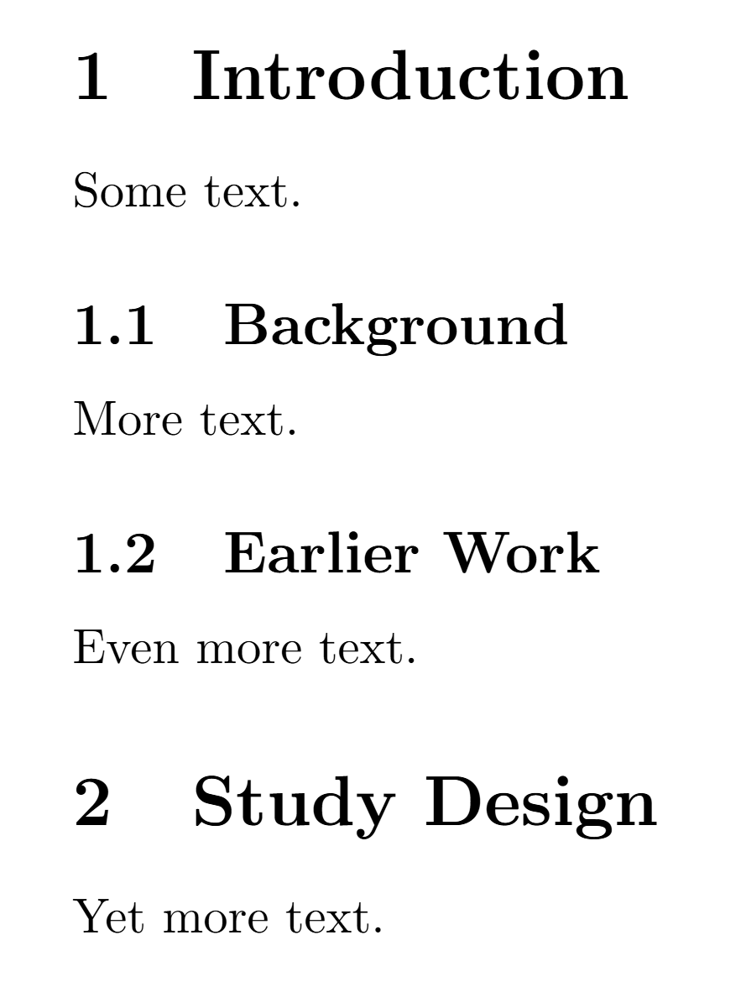
Sections
\section{Introduction}
Some text.
\subsection{Background}
More text.
\subsection{Earlier Work}
Even more text
\section{Study Design}
Yet more text.
Notes:
You can use sections and subsections to break up and categorise your document. Using the commands “section”, “subsection” allows you to specify the name of a section and then specify the content to be contained within the (sub)section.
These will be automatically numbered each time the document is compiled. This means adding a section above an existing section will change the numbering of the existing section.
Overleaf example: https://www.overleaf.com/read/qjqxwmkfjmns#b6c170

Slide 13

Chapters
Problem Sheet
Chapters are not defined in the “article” documentclass, but are in “report” documentclass
\chapter{Conclusions}
\section{Key Findings}
\subsection{Future Work}
Notes:
You can also use chapters to break up some documents into larger sections. The chapter command is an example of a command which is not available in every type of documentclass – it is available in the “report” documentclasses but not in the “article” document class.
In the report documentclass, sections define the second tier of the division of content, and subsections define the third tier.
A chapter will typically start a new page, leave a significant amount of vertical around the title and use very large text for titles.
Overleaf example: https://www.overleaf.com/read/cpkybhpfdgsb
Problem sheet section: Chapters and Sections

Slide 14
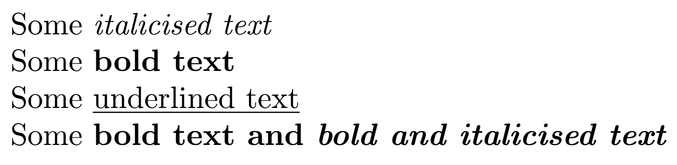
Modifying Text
Problem Sheet
Some \emph{italicised text}
Some \textbf{bold text}
Some \underline{underlined text}
Some \textbf{bold text and \emph{bold and italicised text}}
Notes:
Different command may be used in the middle of normally written text which modifies how the text appears in the final pdf.
The “emph” command italicises text
The “textbf” command makes a text bold
The “underline” command underlines text
These can be combined by nesting the commands inside each other.
Overleaf example: https://www.overleaf.com/read/bmvnftnttnzk
Problem Sheet Section: Modifying Text

Slide 15
Main Font Size
Every document has a main font size.
Other text (captions, section titles, footnotes, etc) are scaled relative to this font-size automatically.
We can change the main font size of a document when selecting the documentclass.
Only certain main font sizes are defined for each documentclass (normally 10pt, 11pt, 12pt).
If we don’t specify, 10pt typically used.
\documentclass[12pt]{article}
Notes:
LaTeX handles font sizes in a very different way to Microsoft Word. In LaTeX you do not explicitly specify the font size of each section of text. Instead, each document will have a main font size. This will be used for standard text in normal paragraphs. Other pieces of text such as section headings, footnote text, figure captions and so on will be scaled relative to this main font size. This means changing the main font size will affect the sizes of all this text, keeping the relative difference in sizes the same.
We can set the main font size when choosing the documentclass at the start of the tex file. Standard classes allow us to use the options 10pt, 11pt, or 12pt. If we don’t explicitly specify, 10pt will normally be used.
This is also a good moment to look at the syntax of this command, as many commands in LaTeX have similar formats. The argument in curly brackets must be provided to the documentclass command. We can optionally include one or more extra arguments in square brackets before the curly brackets. These aren’t necessary for the documentclass command to work, but allow us to specify extra details about how the command should be executed.
Overleaf example: https://www.overleaf.com/read/mvgbhxgkptrk#e51dd6

Slide 16
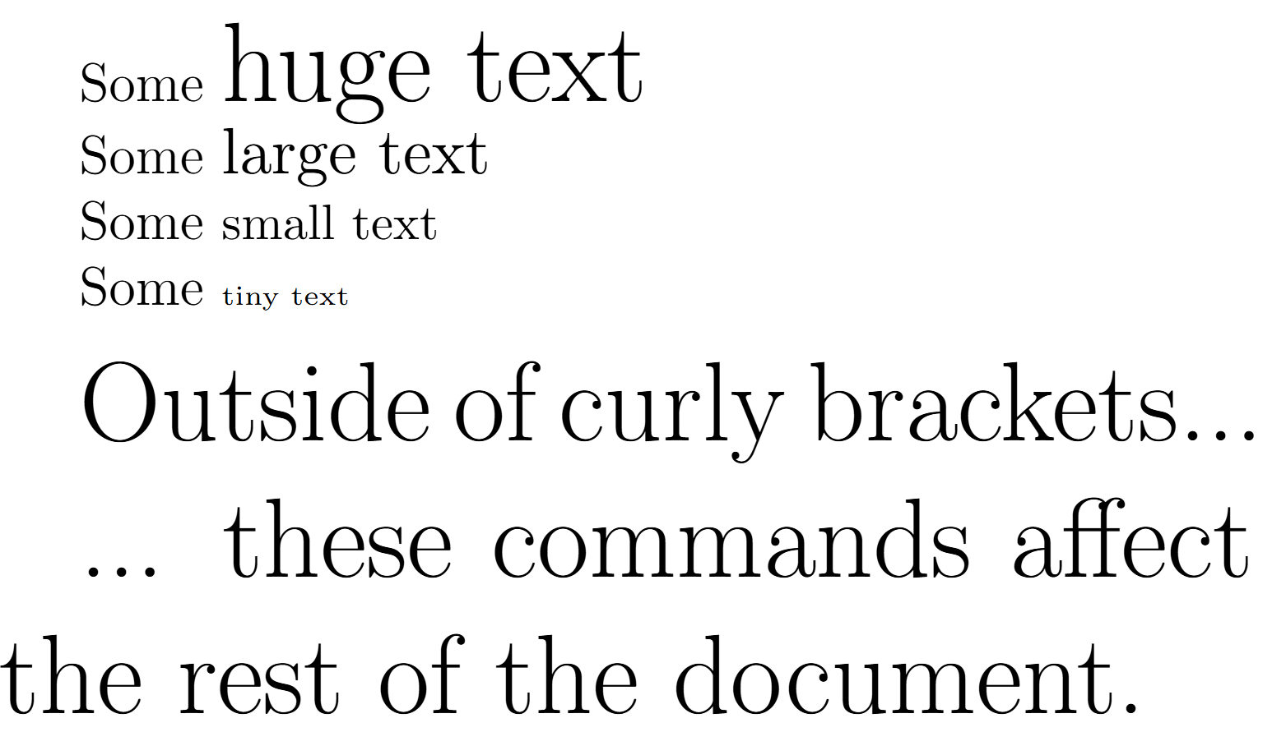
Local Font Size
Some {\huge huge text}
Some {\large large text}
Some {\small small text}
Some {\tiny tiny text}
\huge{Outside of curly brackets...}
... these commands affect the rest of the document.
Notes:
There are a family of commands which can be used to locally specify the size of text relative to the main font size of a document. These commands have a different syntax to the commands like \emph we saw earlier. These commands will affect all text which follows them, even if they are placed before a set of curly brackets. However, we can limit the scope of their effect by placing them inside a set of curly brackets. This causes them to only affect the text in the curly brackets.
Overleaf example: https://www.overleaf.com/read/mvgbhxgkptrk#e51dd6

Slide 17
Local Font Size
Problem Sheet
 | 10pt | 11pt | 12pt
\tiny | 5pt | 6pt | 6pt
\scriptsize | 7pt | 8pt | 8pt
\footnotesize | 8pt | 9pt | 10pt
\small | 9pt | 10pt | 11pt
\normalsize | 10pt | 11pt | 12pt
\large | 12pt | 12pt | 14pt
\Large | 14pt | 14pt | 17pt
\LARGE | 17pt | 17pt | 20pt
\huge | 20pt | 20pt | 25pt
\Huge | 25pt | 25pt | 25pt
Notes:
The table shows the size that different commands will cause text to be based on the main text size of the document.
Problem Sheet Section: Font Size

Slide 18
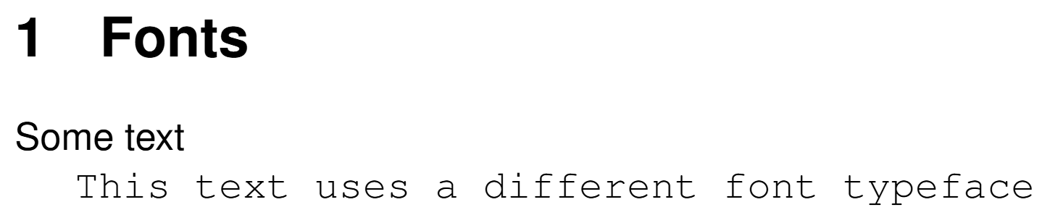
Font Typefaces
Problem Sheet
Add to Preamble
\usepackage[scaled]{helvet}
\renewcommand\familydefault{\sfdefault}
\usepackage[T1]{fontenc}
\usepackage{courier}
\section{Fonts}
Some text
{\fontfamily{pcr}\selectfont
This text uses a different font typeface
}
Notes:
Changing the font in a LaTeX document is a great way to make your document look different from standard LaTeX.
In LaTeX we change the default font of the document, or the font of a single section of the document. This often requires importing a package that contains the font to be used. Unfortunately, fonts are often more complicated than it might feel they should be, and what is required will vary from font to font.
In the example here, we use the helvet package to import the helvet package, which supports the Helvetica font. The line “\renewcommand\familydefault{\sfdefault}” sets this to be the default font for the document. The fontenc package alters the way LaTeX handles fonts, improving how it deals with hyphenation, accented characters, and other features of fonts other than the LaTeX default.
We also use the “courier” package to get access to the Courier font. In the main text, most text, including the section title is rendered in Helvectica (this is a good font choice for accessibility). The commands “\fontfamily{pcr}\selectfont” inside the curly brackets causes the text in the curly brackets to be rendered in Courier. The “{pcr}” is the font code for the Courier font, made accessible when we imported the “courier” package.
You can find more information on fonts, including how to select different fonts on this page: https://www.overleaf.com/learn/latex/Font_typefaces
Overleaf example: https://www.overleaf.com/read/cyxsrhftwghv#6cc77a
Problem Sheet Section: Font Typefaces

Slide 19
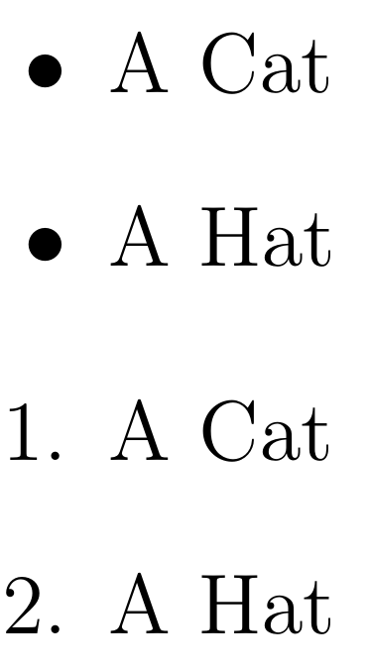
Lists
\begin{itemize}
\item A Cat
\item A Hat
\end{itemize}
\begin{enumerate}
\item A Cat
\item A Hat
\end{enumerate}
Notes:
Bulletpoint and numbered lists can be created easily in LaTeX using the “itemize” and “enumerate” commands respectively. In each case the environment is begun and ended using the “begin” and “end” commands. New items belonging to the list are then signified using the “item” command which is followed by the text associated with that item.
Note that indentation of items isn’t required, but it can make the .tex file easier to read.
Overleaf example: https://www.overleaf.com/read/rvrgkkhvzpwn

Slide 20
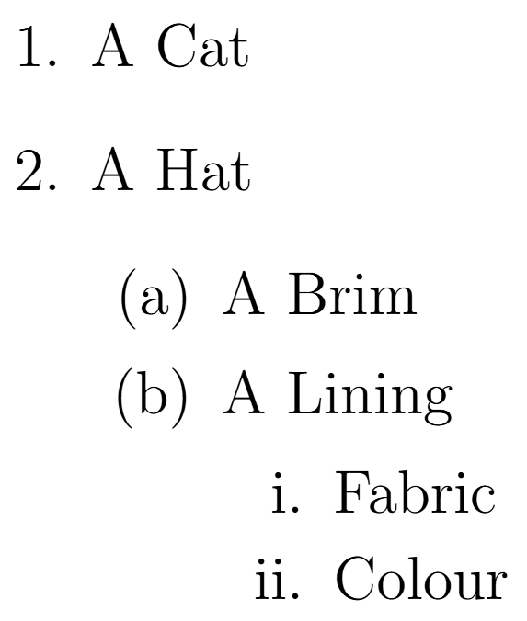
Nested Lists
Problem Sheet
\begin{enumerate}
\item A Cat
\item A Hat
\begin{enumerate}
\item A Brim
\item A Lining
\begin{enumerate}
\item Fabric
\item Colour
\end{enumerate}
\end{enumerate}
\end{enumerate}
Notes:
Lists can also be nested inside each other, resulting in in nested lists. For both enumerate and itemize lists, LaTeX will detect the depth of the list in this nested and use a different set of glyphs for the bullets.
It is also possible to nest an enumerate in an itemize or vice versa.
Overleaf example: https://www.overleaf.com/read/rvrgkkhvzpwn
Problem Sheet Section: Lists

Slide 21
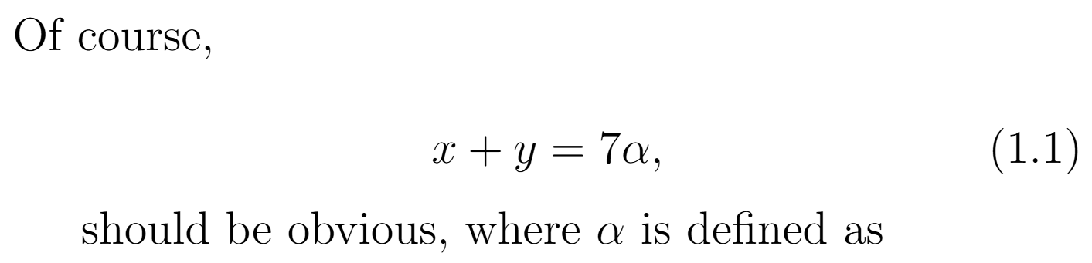
Equations
Of course,
\begin{equation}
x + y = 7 \alpha,
\end{equation}
should be obvious, where $\alpha$ is defined as
Notes:
An equation may be included utilising the equation environment which is, again, started and ended by the “begin” and “end” commands. Text in this environment is interpreted in “mathmode” which changes how the text appears, such as using characters that look like variable names instead of normal characters and allowing the use of mathematical symbols such as the “alpha” symbol we have included with the “alpha” command.
LaTeX automatically numbers equations. For a report documentclass, this will use the number of the chapter, a dot, then the number of that equation within the chapter. If you want to include “mathmode” commands inline with normal text, the “dollar” symbol can be used to start and end “mathmode”.
Overleaf example: https://www.overleaf.com/8251716838wnbtxwjybszb

Slide 22
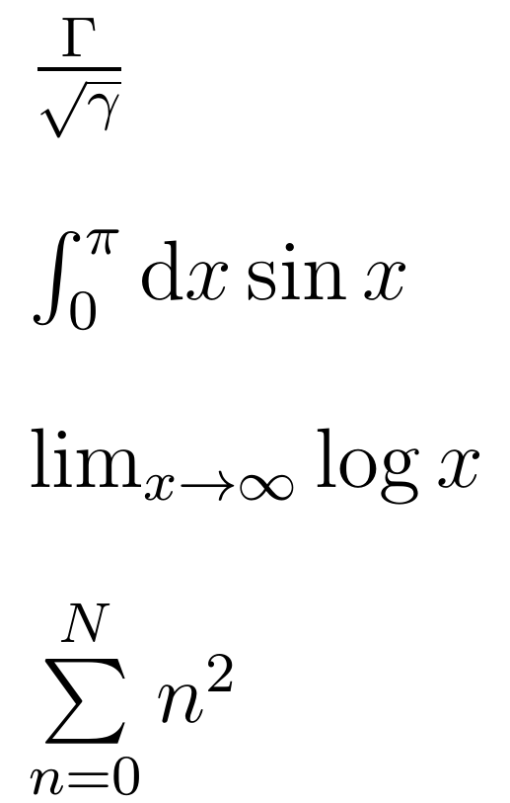
Mathmode Commands
Problem Sheet
$\frac{ \Gamma }{ \sqrt{\gamma} }$
$\int_{0}^{\pi} \textrm{d}x \sin x$
$\lim_{x \to \infty} \log x$
$\sum\limits_{n=0}^{N} n^{2}$
Notes:
Here we’ll look at a few examples of mathmode commands. For many of these, a package (often “amsmath” and “amssymb” will be required to make sure the right commands are available.
In the first command, the “frac” commands has two sets of curly brackets. The numerator is specified within the first pair of brackets and the denominator is specified in the second. We also see the square root command and the appearance of upper and lower case Greek characters.
In the second, we see the integral command. In mathmode, the underscore character, followed by a pair of curly brackets, typically defines text to appear in subscript and the “hat” character typically defines text to appear in super-script.
In the third, we see the commands for limit and log, as well as an arrow to signify “tending toward” and infinity.
In the fourth we see the summation command. Here, we have also used the “limits” command to cause the limits of the summation to appear above and below the summation symbol rather than to the right of it, as with the integration symbol. The use of the “limits” command is not compulsory, but it does look neater. There are a large number of mathmode commands and this is a quick sample of them. Google is your friend in finding specific commands.
Overleaf example: https://www.overleaf.com/read/rwkzhszhmfcd
Problem Sheet Section: Mathmode I

Slide 23
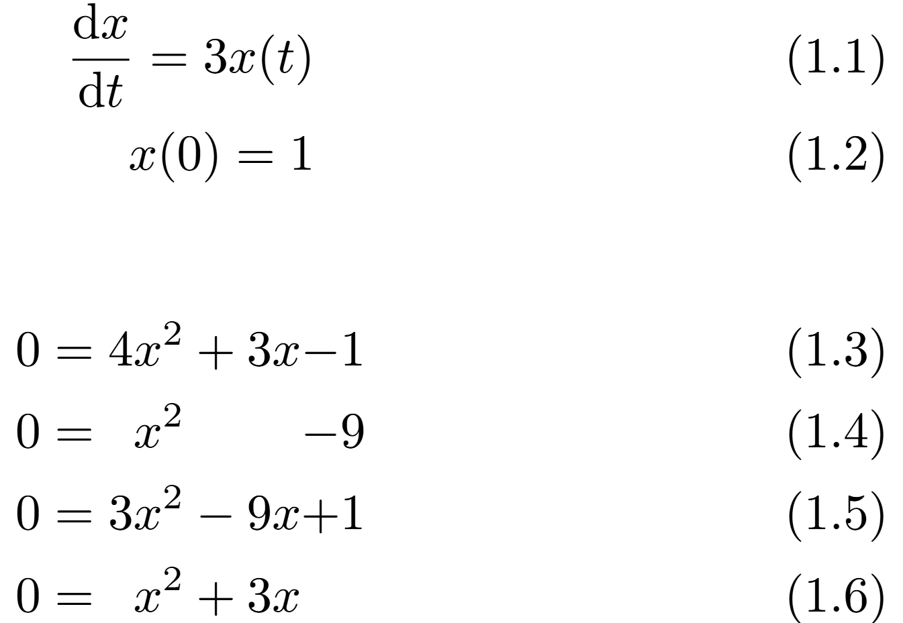
Grouping Equations
Add to preamble
\usepackage{amsmath}
\begin{align}
\frac{\textrm{d}x}{\textrm{d}t} = 3x(t) \\
x (0) = 1
\end{align}
\begin{alignat}{4}
0 & = 4 & x^{2} & + 3x & - 1\\
0 & = & x^{2} & & -9 \\
0 & = 3 & x^{2} & -9x & + 1 \\
0 & = & x ^{2} & +3x
\end{alignat}
Notes:
The “amsmath” package (which is a fairly standard package to use when dealing with maths) introduces some ways of grouping equations. This can be particularly helpful when you have several equations that you want to be displayed together as it prevents them being split on to different pages by a page break. It also groups equations more tightly vertically than using several “equation” environments.
The “align” environment allows us to include multiple equations, separating each with a double-backslash. The last equation of a block like this doesn’t need a double-backslash at the end of it. The contents of “align” are processed in “mathmode” and individual lines in it are treated as different equations for numbering purposes.
The “alignat” environment is similar to the “align” environment but also allows for the addition of alignment points (indicated with the character “&”). The number in curly brackets following the “\begin{alignat}” command defines the maximum number of alignment points per equation (here, it is 4). LaTeX will then ensure the first alignment point in each equation is vertically aligned, and that the second alignment point in each equation is aligned and so on. Each equation doesn’t require the maximum number of alignment points. Alignment can be very useful for ensuring even large blocks of equations are easy to read by aligning equals signs (so it’s easy to spot the left- and right-hand sides of an equation), or other parts of the mathematical structure of the equations.
Overleaf Example: https://www.overleaf.com/read/trrzvqnfwshx
Break for sections 12 and 13 of task sheet

Slide 24
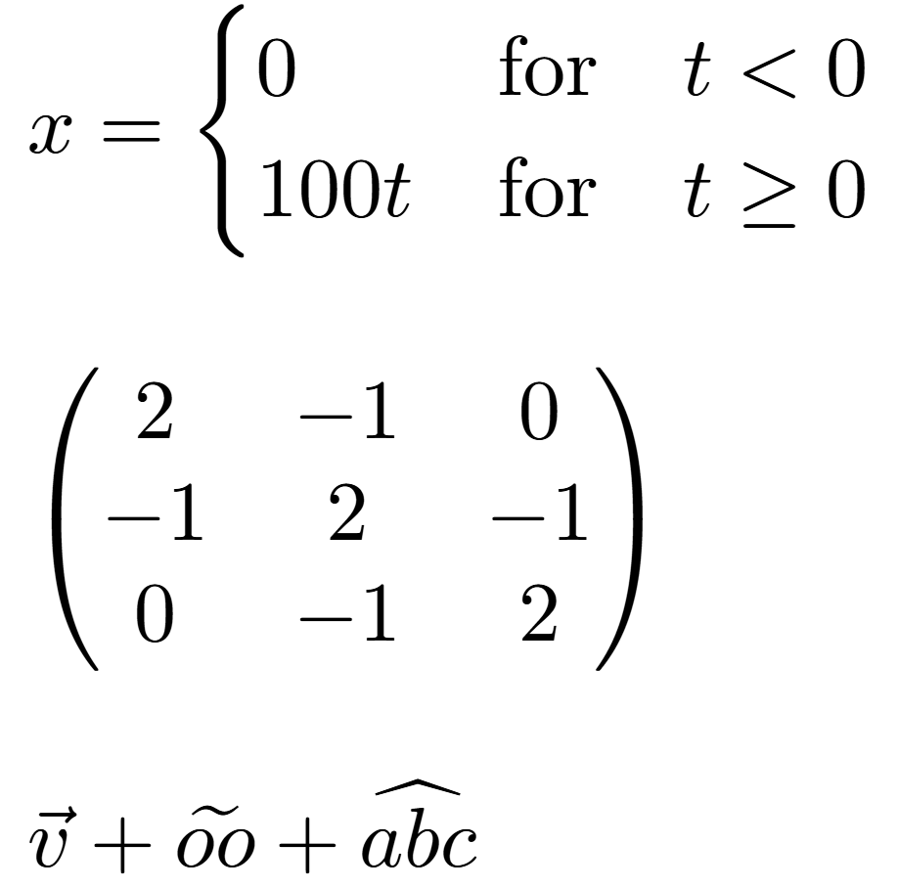
Mathmode Commands 2
Problem Sheet
Add to preamble
\usepackage{amsmath}
$x = \begin{cases}
0 & \textrm{for} \quad t < 0\\
100t & \textrm{for} \quad t \ge 0
\end{cases}$
$\begin{pmatrix}
2 & -1 & 0 \\
-1 & 2 & -1 \\
0 & -1 & 2
\end{pmatrix}$
$\vec{v} + \widetilde{oo} + \widehat{abc}$
Notes:
In the first example, we see the “cases” environment. In mathmode, this allows us to show the value of a variable in different situations using a brace. The different conditions in a brace are separated by a double-slash. You do not need to include a double-backslash after the final condition. The amsmath package allows us to use alignment points in these conditions, which can make these conditions easier to read. The second condition also include the “\ge” command, which creates a greater-than-or-equal-to character.
The second example shows one way of creating a matrix, using the “pmatrix” environment. Again, lines are separated by double-slashes. The elements in each row of the matrix are separated by “&” characters. There are other environments which can be used to create matrices with different styles, such as types of brackets.
The final example shows how you can decorate characters or collections of characters. There are many ways you can add modifiers to characters, so don’t feel restricted in terms of the notation you can use – there are ways to produce almost any effect you might think of.
Overleaf example: https://www.overleaf.com/read/fcsmytpqkfnd#cba4bc
Problem Sheet Section: Mathmode II

Slide 25
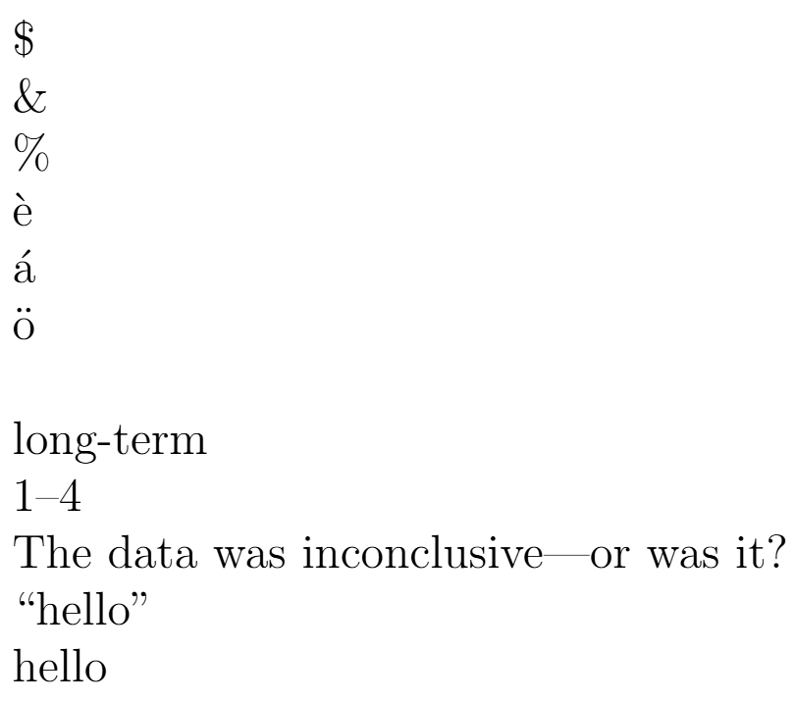
Special Characters
LaTeX inputs in strikethrough-red should not be used.
\$
\&
\%
\`{e}
\’{a}
\"{o}
à
long-term
1--4
The data was inconclusive---or was it?
``hello’’
“hello”
Notes:
Some characters require special commands in LaTeX. This may be because they are characters LaTex uses for other purposes, such as $, & and %. For these characters, you can normally use backslash, followed by that character.
It’s possible to add accents to characters in LaTeX, typically by writing a backslash, a piece of punctuation and then a character in curly brackets. Different punctuation characters will add different accents. Trying to use an accented character in a tex file will not work as the character is not recognised by the LaTeX interpreter. If you want to use characters from a different alphabet/language (like Greek, Russian, or Mandarain) you can do this by using packages.
You can add different types of horizontal dashes using different numbers of hyphen characters. A single hyphen renders a hyphen, used for compound words. A double hyphen gives an en-dash, used to indicated ranges, and a triple hyphen gives an em-dash, used to punctuate a digression in a sentence. Note that different writing styles may vary in terms of which dash to use in different circumstances.
For quotation marks, ` and ‘ give opening and closing quotation marks respectively. Doubles of these give double quotation marks of the corresponding types. Using a double quotation mark will often not produce the desired result.
Note that this means when copying text from other places, such as Word documents or pdf, the wrong character can be inserted. In the final example here, for instance, the double-quotation mark characters are not valid in the LaTeX characterset, so do not render correctly.
Overleaf example: https://www.overleaf.com/read/jsksjfbyghkk

Slide 26
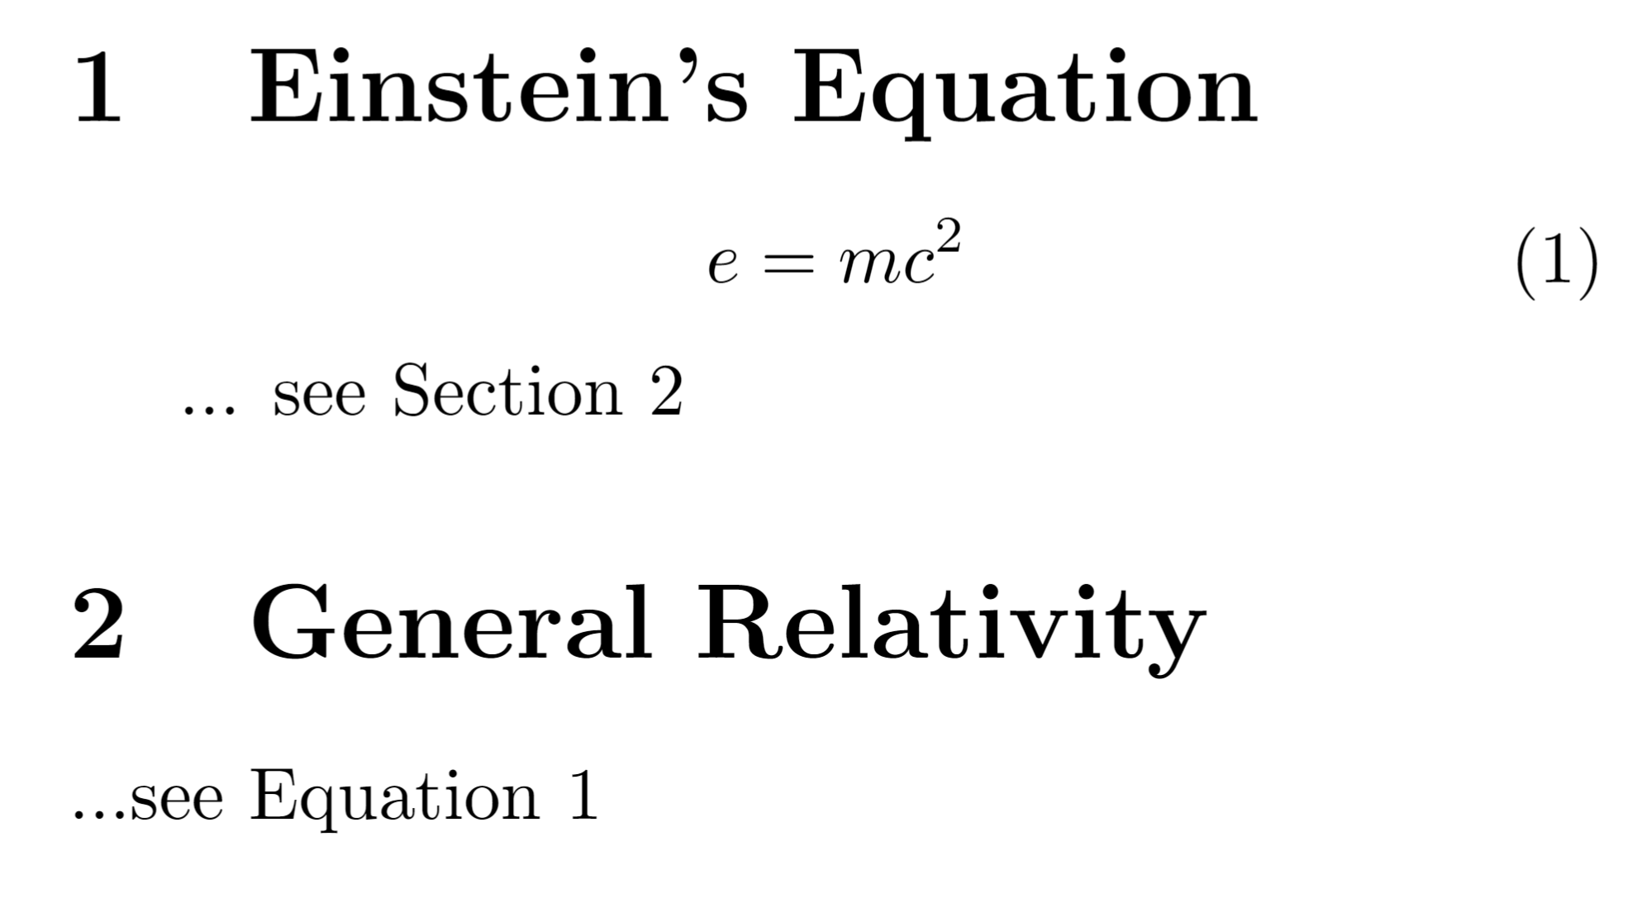
Cross-Referencing
Problem Sheet
\section{Einstein's Equation}
\begin{equation}
e = mc^{2}
\label{eq:energy_mass}
\end{equation} ... see Section \ref{sec:general_relativity}
\section{General Relativity} \label{sec:general_relativity}
...see Equation \ref{eq:energy_mass}
Notes:
LaTeX makes the management of cross-referencing different sections and constructs within the document very easy. The first step is to label the thing you want to reference using the “label” command and specifying the keyword you want to use to reference that entity. If this command is within an equation, figure, table and so on, that is what is being given that label. If it’s not in any of these constructs, the label will be applied to the current section or chapter.
The name you label something with can be anything and will not appear anywhere in your final document, but it must be a unique label. It is wise to make the label something relevant to the construct it is labelling. You may also want to give a prefix such as “eq:” for equations, or “sec:” for sections. This makes it less likely you will accidentally create duplicate labels, and makes it easier to see what labels apply to.
The next step is to reference the entity you labelled. This is typically done using the “ref” command, which is followed by the label of the entity you wish to reference in curly brackets. In the text, this is replaced by the number of the entity referenced. For instance, if you reference the second section, the label command will be replaced by the number “2”.
Note that you can reference labelled entities that occur before or after the reference in the .tex file. If you update your tex file to include more equations, causing the number of the referenced equation to change, the number which appears in the reference will also change in your pdf when you recompile it. This means you can undertake wide-ranging restructuring of your document and references will still automatically point to the right place.
Overleaf example: https://www.overleaf.com/read/xcdwqnttrqzp
Problem Sheet Section: Cross-Referencing

Slide 27
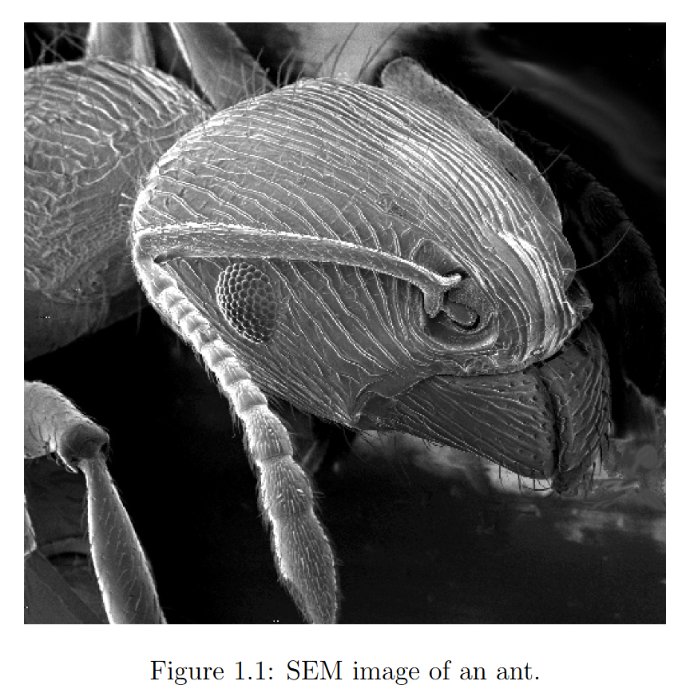
Figures
Add to preamble
\usepackage{graphicx}
\begin{figure}
\centering
\includegraphics[width=10cm]{ant_sem}
\caption{SEM image of an ant.}
\label{fig:ant_sem}
\end{figure}
Notes:
There are several ways to include a figure in LaTeX and a wide range of options that you might use. This is one example of something you might consider. The “\begin{figure}” command tells LaTeX you’re about to define a figure. The “t” in square brackets is an optional argument which tells LaTeX where you would like to put the figure. In this case, you’re asking for the figure to be put on the top of the next page if possible. Conflicts can occur, such as when multiple figures are requested to be included at the same location. LaTeX will do its best to position figures conforming to the locations you’ve specified and also to try and reduce the amount of white space in the document. Other options to be used are “h” which asks the figure to be placed as close as possible to the text above the figure, including the middle of the page. “b” requests the image is placed at the bottom of the page.
The “centering” command lets LaTeX know that you would like the picture to be located centrally horizontally. The “includegradphics” command lets LaTeX know you would like to include a picture file with the name in the curly brackets, “Cat_Box” in this case. Note the file extension is excluded – LaTeX will search for standard image files, e.g. Cat_Box.jpg, Cat_Box.png, etc. By default, this file should be in the same directory as your .tex file. The “width” statement sets the width of the picture.
The caption command allows you to include a caption for the picture which, by default, appears under the picture.
Finally, the “\end{figure}” command ends the specification of the figure.
Overleaf example: https://www.overleaf.com/read/ymfkjjdthvwq

Slide 28
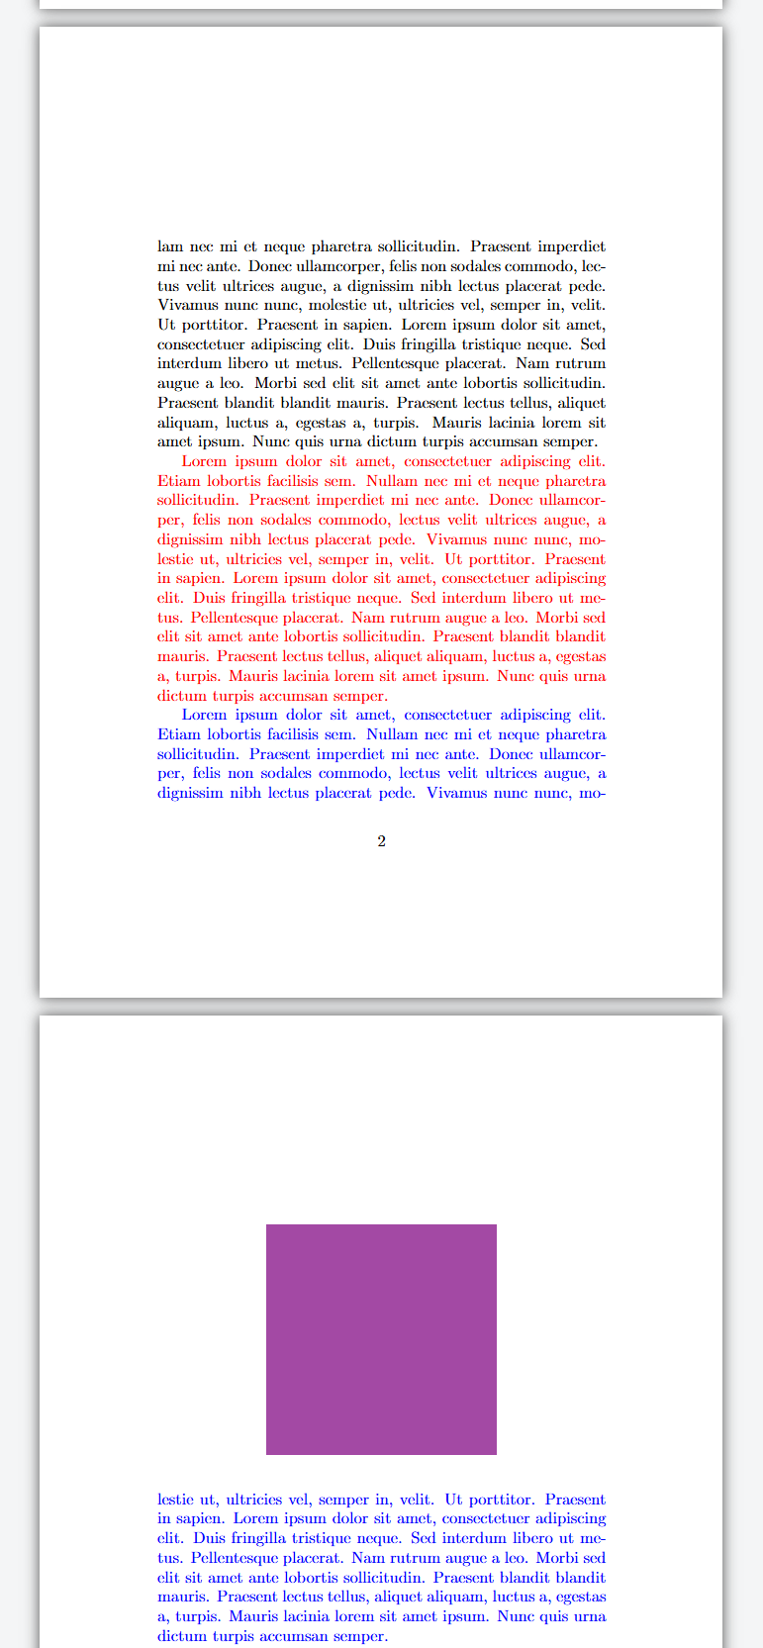
Float Placement
A figure is an example of a float
Placed differently to text, equations, etc
Has a substantial vertical height
Cannot always be place exactly in order compared to the .tex file
LaTeX has internal logic regarding where to place floats
In the example to the right:
The purple figure is defined between the red and blue paragraphs
It can’t fit on the bottom of the page
It is placed on the next page
The remaining whitespace at the bottom of the page is filled with the next paragraph
If a figure is placed alone on the last page of a document, it will be vertically centered
Notes:
A figure is an example of a float in LaTeX. Due to the vertical size of floats, they cannot always be placed in the same order in the pdf as they are defined in the tex file compared to the text around it. By default, LaTeX will place it at the top of the first page that has space at or after the place it is defined.
Overleaf example: https://www.overleaf.com/read/bsdpqdbxkspz#61649f

Slide 29

Float Placement
Problem Sheet
Character | Request
t | Top of a page
b | Bottom of a page
h | As close as possible to the text above and below it – including the middle of a page
p | On a separate page of figures
\begin{figure}[h]
We can request for LaTeX to place a float at a particular place on a page
Add a character after the “\begin{figure}” in square brackets
Can follow with an exclamation mark (e.g. “[h!]”) to ask LaTeX to try really hard
Can also use a sequence to give order of preference (e.g. “[h! tbp])
Default behaviour is defined for each documentclass (e.g. “[tbp]” for articles)
My recommendation: use “[h]” to make it as close as possible
Do not expect to perfectly control where floats go – LaTeX will normally do something sensible and it’s not possible to robustly force it to do something else.
You can refer to floats (e.g. “Figure 1 shows…”) to make the link between text and floats clear.
Notes:
We can have some influence over where floats, such as figures, are placed in LaTeX. This is primarly by adding a character in square brackets after the declaration of a figure. Different characters have different effects. Following this character with an excalamtion mark asks LaTeX to try really hard to place it where you request. You can also specify a series of characters to give an order of preference. Each class has a default behaviour, e.g. [tbp] for articles.
I recommend normally using “[h]” – this ensures your figures will often be as close as possible to the text that relates to it. There are tools you could try to use to force floats and text to be displayed in a particular order. However, this is very difficult to do robustly. For instance, you could have a perfect layout, then add half a page of extra content earlier in the document, and everything will break. LaTeX normally does a reasonable job placing figures and it’s easier and more productive to learn to work with it than try to fight it.
You can also refer to floats from the text, making it clear where each float is relevant to your discussion. We’ll see a neat way to do this later in the course.
Overleaf example: https://www.overleaf.com/read/bsdpqdbxkspz#61649f
Problem Sheet Section: Figures

Slide 30
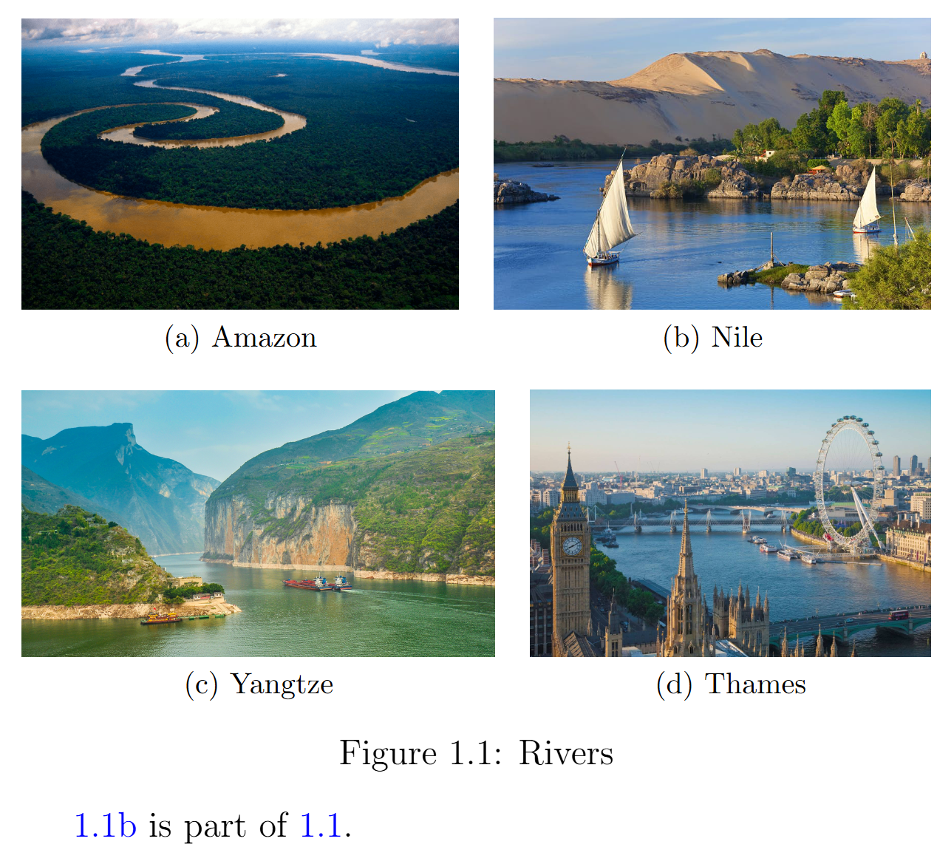
Subfigures
Add to preamble
\usepackage{subfig, graphicx}
\begin{figure}[h]
\centering
\subfloat[Amazon]{\label{amazon}\includegraphics[width= 0.48\textwidth]{amazon_river}} \quad
\subfloat[Nile]{\label{nile}\includegraphics[width= 0.48\textwidth]{nile_river}} \\
\subfloat[Yangtze]{\label{yangtze}\includegraphics[width= 0.52\textwidth]{yangtze_river}} \quad
\subfloat[Thames]{\label{thames}\includegraphics[width= 0.44\textwidth]{thames_river}}
\caption{Rivers}\label{rivers}
\end{figure}
\ref{nile} is part of \ref{rivers}.
Notes:
In LaTeX, a subfigure, is a figure which appears as one of multiple smaller figures within a larger figure. This collection of subfigures will always be placed together as a single figure. There are a few ways to include subfigures in your thesis.
This example uses the“subfig” package. Within the figure environment we use the “\subfloat” command once for each subfigure we wish to include. The “\subfloat” command is followed by the caption of the subfigure in square brackets. Then, in curly brackets, we use the “\includegraphics” command to include the graphics. The square brackets following the “\includegraphics command is here to specify the width of the figure in units of the width of text on the page at this point (which is referenced using the “\textwidth” command). In this case, we’ve asked for each figure to be around half of the width of the text (there’s some variation due to the aspect ratio of each image). Within the curly brackets following the “\subfloat” command we also give each individual subfigure a label so we can reference it later. Following the specification of the first and third figure we use the “\quad” command. This is a way of telling LaTeX to insert a small horizontal space between whatever came before and whatever comes next. Following the specification of the second subfigure we use a double-backslash to start a new line of subfigures within the overall figure we’re creating. This puts the third and fourth figures below the first and second.
Finally, we use the “\caption” command to give the figure that is comprised of the subfigures a caption and the “\label” command to give it a label. We see that we get a nicely spaced array of subfigures, each with their own caption, inside a larger figure which also has its own caption. We can reference any of the subfigures or the containing figure. Overleaf Example: https://www.overleaf.com/read/htdvrmwgcyvd

Slide 31

File Paths
Problem Sheet
It’s often useful to put image files into one or more subdirectories in your project.
Your main directory will be less cluttered
Easier to find individual files
Specify the path to the file, a forward-slash, then the file name.
Like image file names, the subdirectory name shouldn’t contain spaces.
\includegraphics[width=0.9\linewidth]{figures/chicago_pile.png}
Notes:
Once your project reaches a certain size, it’s helpful to organise your image files into one or more subdirectories. This makes your project easier to navigate. You can use files using “\includegraphics” by including the name of the subdirectory, a forward-slash, then the file name in the curly brackets. Like the names of image files, your subdirectory names shouldn’t contain spaces.
Overleaf Example: https://www.overleaf.com/read/hqpbbjtzhfyb#ba0141
Problem Sheet Section: Subfigures and File Organisation

Slide 32
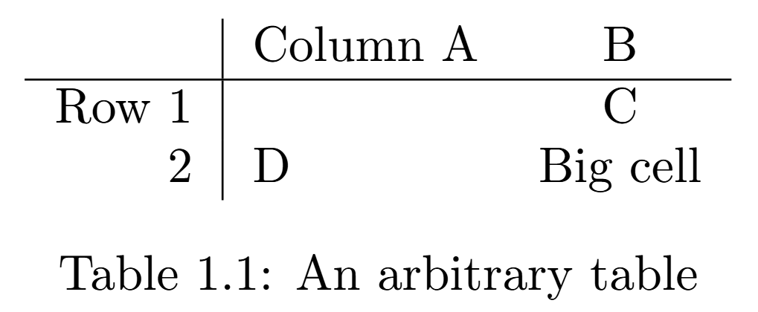
Tables
Problem Sheet
\begin{table}[h]
\centering
\begin{tabular}{ r | l c }
& Column A & B\\
\hline
Row 1 & & C \\
2 & D & Big cell
\end{tabular}
\caption{An arbitrary table}
\end{table}
Notes:
Tables can be included in LaTeX documents in a similar way to figures. The first command “\begin{table}” tells LaTeX to expect a table. In this case, we’ve chosen to include a “h” in square brackets to tell LaTeX to put the table as close as possible to the location it’s been specified in the text. Again, the “centering” causes the table to be centered horizontally on the page. Within the “tabular” environment we specify the contents of the table. In the curly brackets immediately after we begin this environment we specify the columns, their alignment and any lines between the columns. The number of these characters determines the number of columns, and which characters we use specifies the alignment. Here we have specified that we want text in the left column to be right-aligned within the column, text in the middle column to be left-aligned and text in the rightmost column to be centre-aligned within that column. The vertical line between the specification of the first and second column specifies that a vertical line is to be included in the table. If we don’t want a vertical line, as between columns 2 and 3, we don’t include a line. Next, we begin to specify the contents of the table itself. We do this row by row, with rows separated by a double backslash. It’s not required to put each line of the table on a new line of your .tex file, but it’s a good idea as it makes your file easier to read. Ampersands separate the specification of material within each column of the current row. In this case, for row 1, we include an ampersand before any text, causing the first column of row 1 to be empty. In rows 2 and 3 we specify something before the ampersand, so column 1 has entries in these rows. Between the specification of lines 1 and 2 we use the “hline” command to specify the inclusion of a horizontal line between these rows. Finally, we end the tabular and table environment with the corresponding “end” commands.
The indentation of various lines is not required but can make the code easier to read.
Overleaf example: https://www.overleaf.com/read/dbmrcfcdhgsg
Problem Sheet Section: Tables

Slide 33
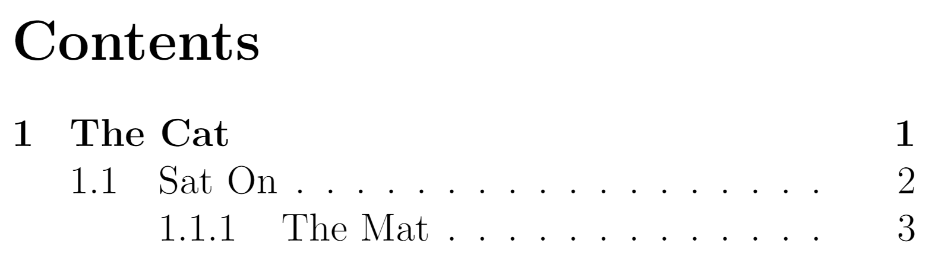
Table of Contents
\tableofcontents
Notes:
A Table of Contents may be easily inserted using the command “tableofcontents” command, which automatically detects the page numbers of chapters, sections and so on. The table of contents will be inserted at the point in the document where the command is used.
Overleaf example: https://www.overleaf.com/read/gjdnkmkdnnqd

Slide 34
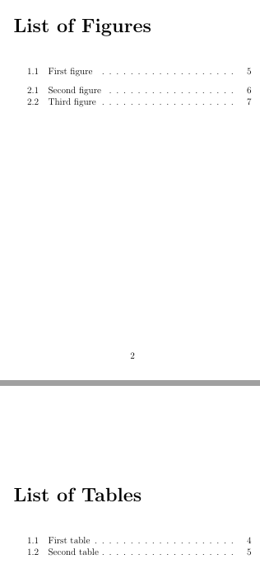
List of Tables and Figures
\listoffigures
\listoftables
Notes:
By using the “\listoffigures” and “\listoftables” commands you can insert a list of figures and list of tables respectively. Note that figures and tables are numbers are labelled “X.Y” where “X” is the chapter number and “Y” is the number of the figure/table in that chapter. The lists also slightly groups figures and tables by chapter.
Overleaf Example: https://www.overleaf.com/read/xqrwgcydcznt

Slide 35
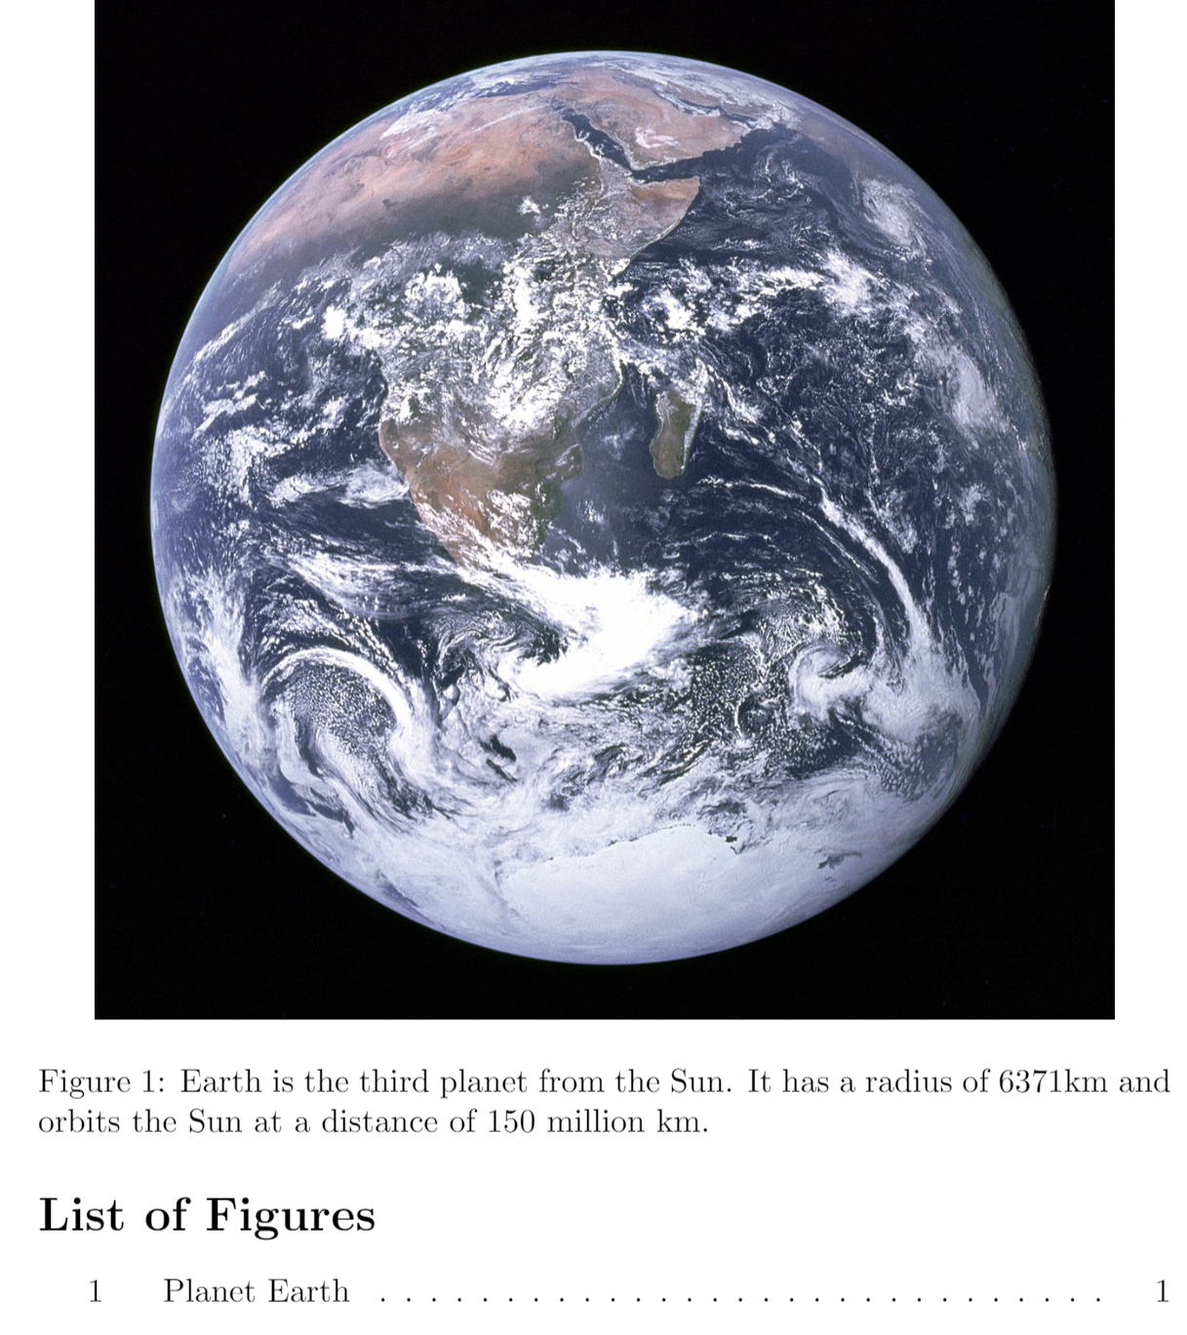
Short Captions
Problem Sheet
\listoffigures
\begin{figure}
\centering \includegraphics[width=0.9 \textwidth]{earth}
\caption[Planet Earth]{Earth is the third planet from the Sun. It has a radius of 6371km and orbits the Sun at a distance of 150 million km.}
\end{figure}
Notes:
Sometimes when writing a caption you might want to use a long caption to give a lot of information about the figure, table, etc. However, the same caption would take up a lot of space and give unnecessary detail in the list of figures or list of tables. In this case, it’s possible to specify a shorter caption to be used in the list of figures or list of tables by specifying it in square brackets after the word captions and before the full caption which is specified in curly brackets.
Because of the way the captions for subfigures are defined/used, it’s not possible or necessary to do this for subfigure captions, although it is possible to specify a short caption for a figure which contains subfigures.
Overleaf example: https://www.overleaf.com/read/kjjswpdcxsfn
Problem Sheet Section: Table of Contents, List of Figures and List of Tables

Slide 36
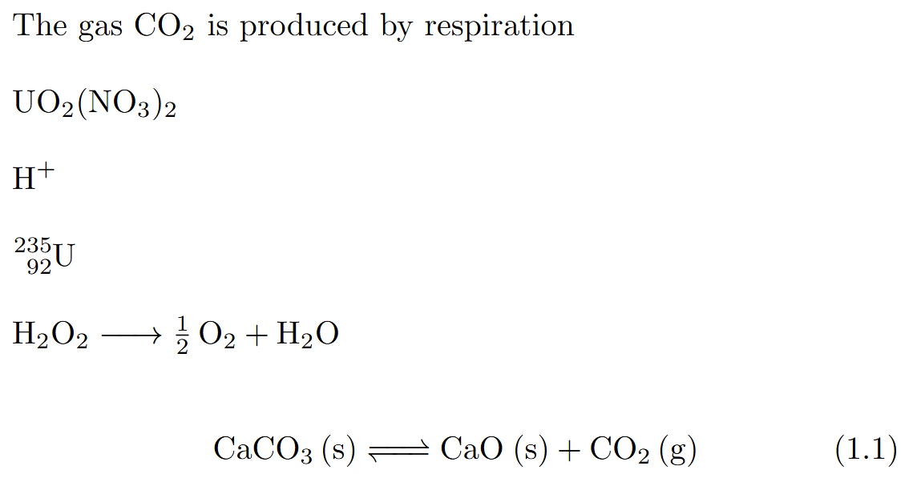
Chemical Formulae
Add to preamble
\usepackage[version=4]{mhchem}
The gas \ce{CO2} is produced by respiration
\ce{UO2(NO3)2
\ce{H+}
\ce{^{235}_{92}U}
\ce{H2O2 -> 1/2O2 + H2O}
\begin{equation}
\ce{CaCO3 (s) <=> CaO (s) + CO2 (g)}
\end{equation}
Notes:
The mhchem introduces a range of functionality to represent chemical formulae and reactions. When importing it, it can be useful to explicitly specify which version of the package is being imported.
The command “\ce” is followed by a set of curly brackets containing the specification of the chemical formula. This can be included as part of normal text, or in mathmode, such as in an equation.
Within the curly bracket letters are used to represent the symbols of the elements present. If a number appears directly after a letter, it represents the number of atoms of that element in the molecule. Numbers appearing at the start of a molecule represent the number of those molecules, for instance in a reaction. By writing “1/2” or similar before the name of the molecule allows fractional amount to be specified. Brackets can be inserted using the open/close parentheses “()”.
Ionic charges can be represented using “+” or “-”. Atomic numbers and atomic masses can be specified in a similar way to subscript and superscript text in mathmode, using “_{}” and “^{}” respectively. The state of a molecule can be represented by placing the relevant character in a set of curly brackets, such as “(s)”.
There are symbols that can be used to indicate the direction of a reaction, such as “->” for a left-to-right reaction, or “<=>” for a reversible reaction. It’s advisable, and often required, to separate molecules and reaction symbols with a space.
Overleaf example: https://www.overleaf.com/9489358344nhssrdtdvvzy#dbf256

Slide 37
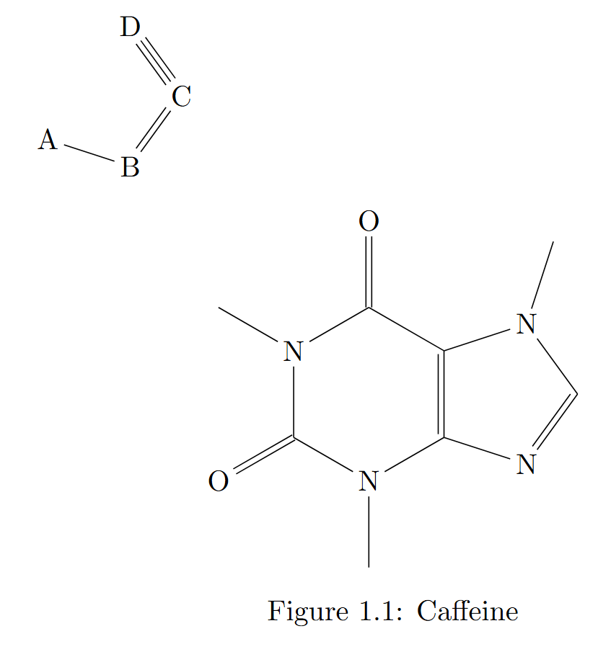
Skeletal Structure Diagrams
Problem Sheet
Add to preamble
\usepackage{chemfig}
\chemfig{A*5(-B=C~D)}
\begin{figure}[h]
\centering
\chemfig{*6((=O)-N(-)-(*5(-N=-N(-)-))=-(=O)-N(-)-)}
\caption{Caffeine}
\end{figure}
Notes:
The chemfig package allows us to include skeletal structure diagrams that are common on organic chemistry. This package allows us to use the “\chemfig” command which is followed by a set of curly brackets which contain the specification of the diagram.
Inside these curly brackets, a “*” represents a ring beginning with the preceding character. The number after the “*” shows how many nodes are on the ring. This if followed by a set of parentheses which contain the bonds and symbols around the ring in an anti-clockwise direction. “-” represents a single bond, “=“ represents a double bond, and “~” represents a triple-bond. If there are not enough bonds specified to complete the ring, it will be incomplete.
At a node of the ring, including a series of bonds and symbols inside of a set of parentheses can specify a branch from the ring. This can include a new ring.
These skeletal structure diagrams can be included in a figure.
Overleaf example: https://www.overleaf.com/read/ydfyzfhhpbwp#c238f2
Problem Sheet Section: Chemical Formulae

Slide 38
Splitting Your Document
Disadvantages of large .tex file
Difficult to navigate
Slow to compile
Split document into many .tex files
Notes:
Many large documents can be difficult to navigate if specified in a single .tex document. Finding the place where chapter 2 is specified will take time, and you’ll have better things to spend it on.
In addition, when you’re typesetting, you’ll often want to recompile your pdf multiple times to test formatting. If you must recompile your entire document every time, it will be a slow process.
One strategy which solves both issues is to split your thesis into several .tex files.

Slide 39
Splitting Your Document
main.tex
\begin{document}
\include{external_1}
\include{external_2}
\end{document}
\begin{document}
\chapter{First Chapter}
\chapter{Second Chapter}
\end{document}
=
external_1.tex
\chapter{First Chapter}
external_2.tex
\chapter{Second Chapter}
Notes:
The key to doing this is the “\include” command. The three files on the right produce the same pdf as the single file on the right. The include command specifies the name of another .tex file to be included (don’t include the .tex extension). The files will be processed as though the commands were in a single continuous .tex file, with the exception that a new page will be inserted before the included material.
In the .tex files you’re including, don’t include preamble commands (such as “\usepackage” or “\begin{document}” or “\end{document”.
You cannot include a .tex file that includes another .tex file. Overleaf Example (unsplit document): https://www.overleaf.com/read/sqwvtspkbchs Overleaf Example (split document): https://www.overleaf.com/read/cmhxwpmfzrjj

Slide 40
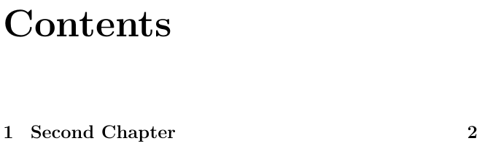
Splitting Your Document
Problem Sheet
main.tex
\includeonly{external_2}
\begin{document}
\tableofcontents
\include{external_1}
\include{external_2}
external_1.tex
\chapter{First Chapter}
external_2.tex
\chapter{Second Chapter}
Notes:
To cause only a subset of included files to be used when the pdf is being compiled, the “\includeonly” command can be used in the preamble. This is followed by a list of .tex files, separated by commas, which specify which included .tex files are to be used. Note that, in this example, this means the “second” chapter is included and is labelled chapter 1, but the “first” chapter is not included at all.
By excluding files in this way, you can dramatically speed up the compilation of the pdf. If you’re working on a very large document and you’re compiling it many times, this can save you a lot of time.
It can be useful to insert a “\includeonly” command when starting to work intensively on a part of the document, then delete it when you’re finished working on that part of the document.
Overleaf Example: https://www.overleaf.com/read/ygsypywvjrhb
Problem Sheet Section: Splitting Your Document

Slide 41
Bibliography Management
Many documents will have many references
There are many ways to include references and citations in LaTeX
Many reference management programs allow the exporting of bibliogrpahies in a .bib file
Notes:
Publications often have dozens of citations and a thesis may have dozens or hundreds of references and so a good way to manage with your references is desirable. There are many ways to manage your references and many ways to personalise your citations. We’re going to run through one way to achieve a streamlined approach to referencing. Many reference managers such as EndNote, Mendeley and Zotero allow for your database of references to be exported as a “.bib” file. This is essentially a database of your references that LaTeX can interact with directly. This means you only need to enter your reference details once in your reference manager and it will feed through to your LaTeX documents including your thesis. If you combine this with the automatic population of fields in your reference manager, you will never need to manually write the details of a reference again. This saves a lot of time and effort you can better spend elsewhere.

Slide 42
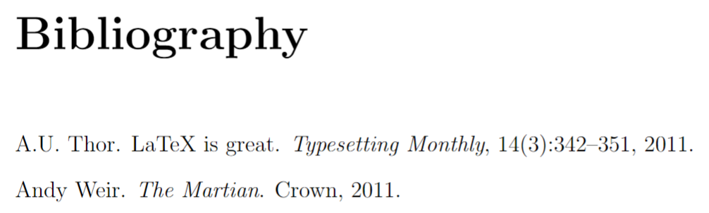
Bibliography Management
myrefs.bib
@article{Thor_2011,
author = "A.U. Thor",
title = "{LaTeX} is Great",
year = "2011",
journal = "Typesetting Monthly",
volume = "14",
number = "3",
pages = "342--351" }
@book{Weir_2011,
author = “Andy Weir",
title = “The Martian",
year = “2011",
publisher = “Crown"}
Notes:
A “.bib” file consists of one entry for each reference. A new entry is begun with a “@” symbol and the name of the type of entry it is. Here, we have one article and one book. There are many other types such as “report”, “conference” and even “phdthesis”. See here for some more examples: https://www.verbosus.com/bibtex-style-examples.html
Within curly brackets, the first entry is a label for your reference. Following that, we then have a series of fields which define the contents of the reference. These come in the format “field name = field value” and are separated by commas. The values should be surrounded by quotation marks or curly brackets. Different entries are valid for different entry types. For instance, both our entries here have “author”, “title” and “year” fields but the article has the fields “journal”, “volume”, “number” and “pages” fields whilst the book has a “publisher” field. When you compile your main .tex file, your bibliography will appear and any entries that are cited will appear in your bibliography. Entries you have not cited will not be included by default.
Overleaf example: https://www.overleaf.com/read/tfrbytxxqszf

Slide 43
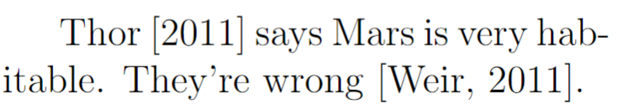
Bibliography Management
Problem Sheet
main.tex
\usepackage{natbib}
\begin{document}
\citet {Thor_2011} says Mars is very habitable. They're wrong \citep {Weir_2011}.
\bibliographystyle{plainnat}
\bibliography{myrefs}
Notes:
In your main .tex file, you need to use the package “natbib” in your preamble. You can then cite a reference using the “citet” command with the label of the reference. This produces a reference which is “textual” in the sense that the author name is written in normal text as if it’s being read as part of the sentence. You can also use “citep” to include the entire reference within brackets. This can be useful for when you don’t intend for the reference to be read as part of the sentence, but to act as an addendum, or to provide evidence for the sentence. After the main body of your text, select a bibliography style (we’ll use “plainnat” for now). Then, use the “\bibliography” command to insert your bibliography into your document. This is followed by the name of your “.bib” file in curly brackets (do not include the “.bib” extension here). Your bibliography will be inserted at the point of the document where you use this command, so the “\bibliographystyle” and “\bibliography commands are often found at the end of the document.
Overleaf example: https://www.overleaf.com/read/tfrbytxxqszf
Problem Sheet Section: Bibliographies I

Slide 44
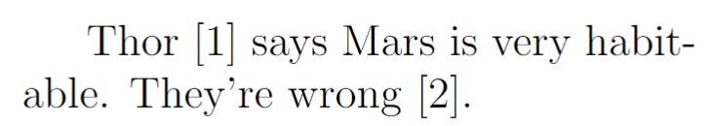
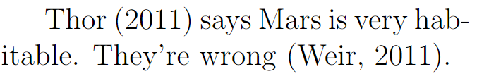
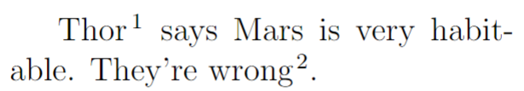
Bibliography and Citation Formats
\usepackage[numbers]{natbib}
\usepackage[round]{natbib}
\usepackage[super]{natbib}
Notes:
There are several different ways you can format your references. Here we’ll look at different options you can use with the natbib package which will alter how your reference appear. Using the “numbers” option will cause you to use numerical references instead of textual references. “round” will cause your references to use round brackets instead of square brackets. “super” causes your citations to appear in super-script, like a footnote.
Overleaf Example (numbers): https://www.overleaf.com/read/nyhjxjvhvqpk
Overleaf Example (round): https://www.overleaf.com/read/dfvnydjfjpfb
Overleaf Example (super): https://www.overleaf.com/read/zgtgtvqhcvfc
The library provides guides on how to format your references to match some common styles: https://library-guides.imperial.ac.uk/c.php?g=719784&p=5221129
Harvard: https://library-guides.imperial.ac.uk/c.php?g=719784&p=5224027&preview=76e2c9b68e68d2b3787ba04ef6b2e5ff
Vancouver: https://library-guides.imperial.ac.uk/c.php?g=719784&p=5224028&preview=76e2c9b68e68d2b3787ba04ef6b2e5ff
IEEE: https://library-guides.imperial.ac.uk/c.php?g=719784&p=5224029&preview=76e2c9b68e68d2b3787ba04ef6b2e5ff
Some of these require you to find a .bst file. This is a bibliography style file which contains formatting information that can be used in the \bibliographystyle” command.

Slide 45
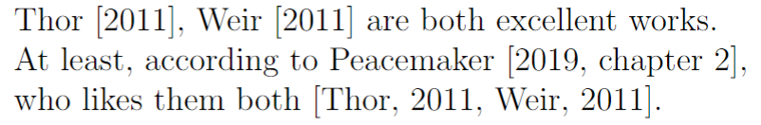
More Ways to Cite
\citet {Thor_2011, Weir 2011} are both excellent works. At least, according to \citet [chapter 2] {Peace_2019}, who likes them both \citep {Thor_2011, Weir_2011}.
Notes:
There are more ways you can make a citation. You can include multiple citations within a single “citet” or “citep” command, separating them with commas. You can also provide additional details, such a referencing a chapter number by including them in square brackets between the “cite” command and the curly brackets.
Overleaf Example: https://www.overleaf.com/read/cqbhnvfsfzpp

Slide 46
Bibliography Complications
Some characters may not be correct when exported directly from a reference manager – you may need to manually edit these
Capitalisation and organisational names
{NASA}
{National Aeronautics and Space Administration}
Accents
Ren\’{e}e
Mathematical symbols
$\gamma$
Special characters (common in urls)
\_
\&
\%
Chemical Symbols (remember to use the “mhchem” package in your preamble)
\ce{H2O}
Notes:
There are a few complications that often occur regarding references and bibliographies. These are problems that often occur when you create a .bib file from a reference manager and it will insert the symbols directly from the title, author name, etc directly into the bib file, without converting them to valid LaTeX code.
The first is capitalisation. In titles and names, LaTeX will use its own rules for capitalisation. In titles, the default is to make everything lower-case. This can prove a problem, particularly for acronyms. However, you can force LaTeX to preserve your original capitalisation by placing the phrase in curly brackets. Placing text in curly brackets is also useful for organisation names – we want to stop LaTeX treating them like an author with a first name and a surname. Placing them in curly brackets does this. If you include accented letters in your bibliography, this will not result in an accent appearing in your bibliography as LaTeX doesn’t know how to parse the character. Instead, you need to include the LaTeX code for accented character in your “.bib” file.
To insert mathmode characters, you can use $ signs to enclose the mathematical content.
You can insert chemical formula by using “\ce”.
Overleaf example: https://www.overleaf.com/read/dtmgtyzvkxmm#86138e

Slide 47
Suggested Bibliography Workflow
Problem Sheet
Add a new reference to your reference manager. Allow it to autocomplete the fields
Check the fields are correct.
Export just that item as a .bib file
Copy/paste it to the end of your existing .bib file
Cite it
Check the new reference and citation renders correctly
Fix any mistakes in the .bib file
Notes:
One common task you might find while working on an academic document is adding a newly found reference to your bibliography. There are a few ways you could do this.
I would suggest adding the pdf of the reference to your reference manager, allowing it to autocomplete the fields and checking the results. Then export just that item to a bib file, a copy/pasting it to the end of your existing bib file in your project. Cite it, then check the citation and the reference in the bibliography look correct, including check for any of the formatting problems from the last slide. Finally, fix any mistakes that remain.
This workflow means you do minimal typing and make use of the convenience of the reference manager. It also means your bib file can contain LaTeX-specific formatting without having to make changes to what is stored in your reference manager.
Problem Sheet Section: Bibliographies II

Slide 48
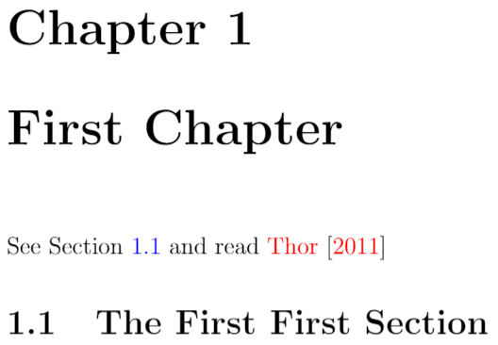
Hyperlinks
Problem Sheet
Add to preamble
\usepackage[colorlinks=true, linkcolor=blue, citecolor=red]{hyperref}
\chapter{First Chapter}
See Section \ref{first_first_section} and read \citet{Thor_2011}.
\section{The First First Section}\label{first_first_section}
Notes:
Normally, references will produce the correct number for the referenced section, figure, etc in a standard text form. However, we can turn them into active hyperlinks that will allow a user to jump to the relevant point in your document by clicking on the reference. You can modify your document so all references are turned into hyperlinks in this way using the “hyperref” package. This package has several options you can use to customise your references. I strongly recommend setting the “colorlinks” option to “true”, feel free to experiment with what it looks like when you don’t do this. You can also set the colour of your links using the “linkcolor” option and colour of your citations using the “citecolor” option. Hyperlinks can make navigating a very large document much easier. Overleaf Example: https://www.overleaf.com/read/tzdbtmdmtfhd
Problem Sheet Section: Hyperlinks

Slide 49
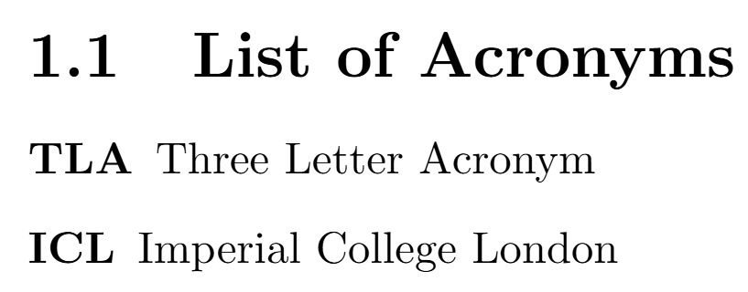
Acronyms
Add to preamble
\usepackage{acronym}
\acrodef{NHLI}{National Heart and Lung Institute}
\section{List of Acronyms}
\begin{acronym}
\acro{TLA}{Three Letter Acronym}
\acro{ICL}{Imperial College London}
\end{acronym}
Notes:
The acronym package provides a useful way to deal with acronyms in your document. There are two main ways to define an acronym. The first is to use the “\acrodef” command in the preamble. This is followed by two sets of curly brackets. The first contains the abbreviated version of the acronym. The second contains the full version of the acronym. The definition of an acronym in this way does not cause any text to render in the pdf.
The second way to define acronyms is in the“acronym” environment. Here, you can use the “\acro” command to define an acronym. This command is followed by two sets of curly brackets. The first contains the short version of the acronym. The second contains the expanded version of the acronym. Defining acronyms in this way creates a list of acronyms at the location of the “acronym” environment in your pdf. Overleaf Example: https://www.overleaf.com/read/jqsvjjpgjzjp

Slide 50
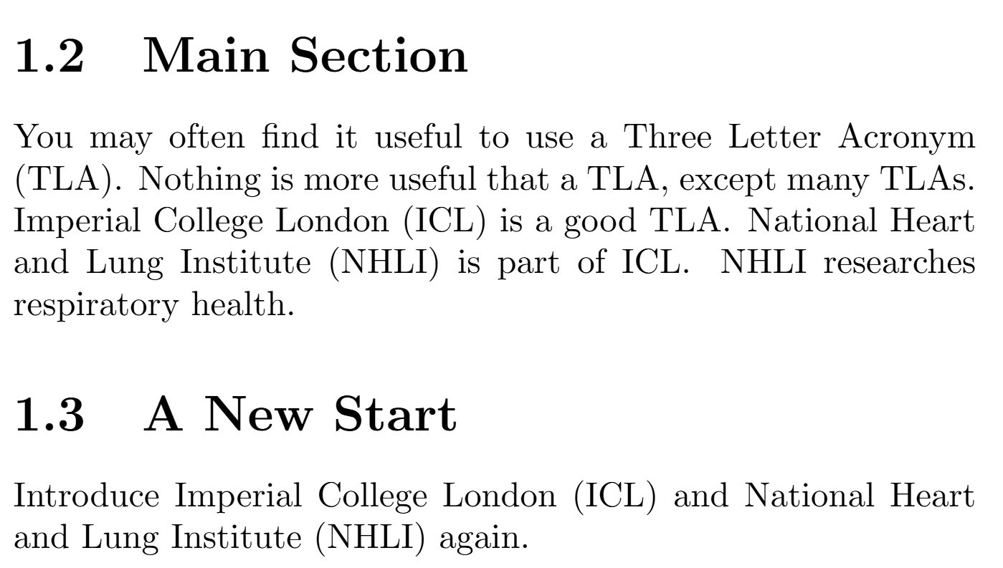
Acronyms
\section{Main Section}
You may often find it useful to use a \ac{TLA}. Nothing is more useful that a \ac{TLA}, except many \ac{TLA}s. \ac{ICL} is a good \ac{TLA}. \ac{NHLI} is part of \ac{ICL}. \ac{NHLI} researches respiratory health.
\section{A New Start}
\acresetall
Introduce \ac{ICL} and \ac{NHLI} again.
Notes:
In the main text you may use the commands “\ac” to insert the acronym. The first time an acronym is used this way both the expanded and contracted version of the acronym will be inserted. In subsequent cases only the contracted version is used.
The “\acresetall” command resets all acronyms so the next time they’re used they will be written out in full. This could be used in large documents if you want to cause acronyms to be reintroduced every chapter, for example. Overleaf Example: https://www.overleaf.com/read/jqsvjjpgjzjp
Problem Sheet Section: Acronyms

Slide 51
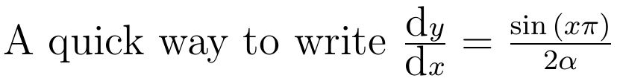
Custom Commands
Problem Sheet
Add to preamble
\newcommand{\hardmaths} {\frac{\sin{(x\pi)}} {2\alpha}}
\newcommand{\diff}[2] {\frac{\textrm{d}{#1}} {\textrm{d}{#2}}}
A quick way to write $\diff{y}{x}=\hardmaths$
Notes:
In your preamble you can use the “\newcommand” command to define a new command. This is a little like defining a macro or a function in other programs or languages. “\newcommand” is followed by the name of the command in curly brackets. LaTeX command names can only contain letters. This is followed by the number of arguments the command (if there are arguments to the command). This is followed by the text that will be used in the body of the .tex file where the command is used. In this definition, if “#X” is included within curly brackets, this will insert the Xth argument in the text used.
To use the command in the document, you can use “\COMMAND_NAME” to invoke the command. This is followed by a the arguments of the command, each in their own set of curly brackets. This can be very useful for automating text you use repeatedly that is the same or similar every time but is long-winded to write out. It’s also possible to redefine existing commands or define new environments, but this won’t be covered in this course.
Overleaf Example: https://www.overleaf.com/read/hxttrgqqvpyp
Problem Sheet Section: Custom Commands

Slide 52
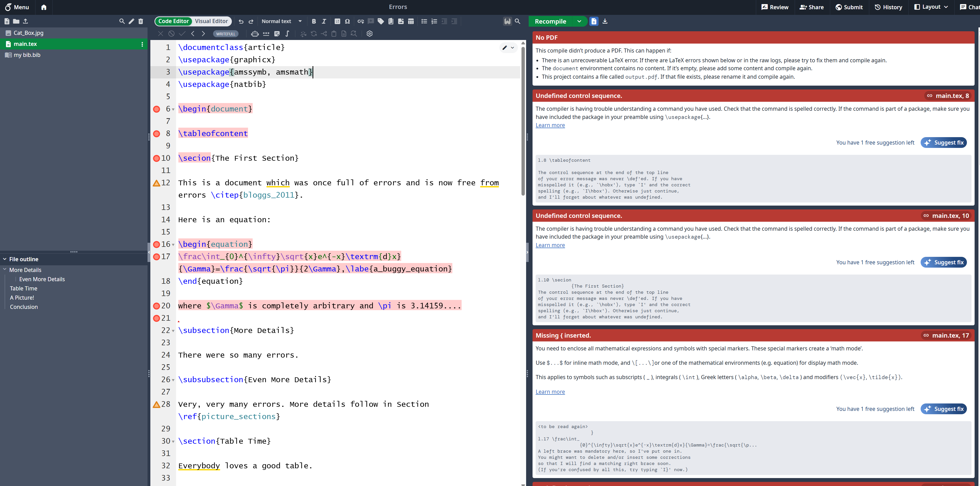
LaTeX Errors
Problem Sheet
Notes:
As LaTeX runs, it keeps a log of what it’s doing. Most of these messages can be safely ignored. However, one class of message that is very helpful is the error message. Overleaf, like all LaTeX compilers will keep a log of all messages is generated. When LaTeX hits a section of code with an error, it will typically generate a useful error message and stop the production of a pdf. If you carefully read the messages, they often lead you straight to the source of the error.
LaTeX will normally tell you what the error is and on what line of the file the error occurred. Overleaf takes this a step further and shows you a small error symbol next to the line number. You can hover over this to read the error message. The full message log can be read by clicking the “Log and Output Files” button next to the “Recompile” button just above where the pdf is normally displayed. When you receive an error from LaTeX (in Overleaf, or from whatever LaTeX compiler you’re using), read the error message, edit your tex file to correct the error and recompile the pdf. Hopefully, you will have fixed the error. Otherwise, you’ll receive another error message. LaTeX will also give you warnings, telling you if there was something it wasn’t sure what to do with, but was able to complete the document in any case. It’s also a good idea to look through the entire pdf by eye for anywhere that you’ve given a valid instruction, but one that has produced a different result to what you wanted.
When tackling errors, it’s often worth correcting the earliest error first – sometimes doing so will fix subsequent errors. When an error appears, it can also be worth looking in the few lines above the error – sometimes an error like an unclosed brackets doesn’t resolve into an error until a later line in the .tex file, resulting in the error being reported after the problem occurred.
Latex example: https://www.overleaf.com/read/gnzphcnqgfvf
Problem Sheet Section: Errors

Slide 53
Useful Online Tools
Google
Stack Exchange
Overleaf
Wikibook
Table Maker
Equation Editor
Mathpix
Detexify
Notes:
If you want to do something in LaTeX but don’t know how, the first thing to do is to Google it. Somebody has almost certainly had your problem/desire before and you can copy their solution most of the time. On many occasions, you’ll find the answer of stackexchange. As well as being a useful environment to develop and run LaTeX, Overleaf has an extensive library of documentation on LaTeX’s functions. There’s also a very good wikibook that contains a good description of the functionality of LaTeX. There’s also a good table maker which allows you to define tables in a more natural and graphical way and have it return the equivalent LaTeX code. There’s also an equation editor which allows you to define equations in a more graphical fashion and have it return the equivalent LaTeX code. Mathpix can look at images of equations, tables, etc and produce equivalent LaTeX code. Detexify can use machine learning to identify which LaTeX would render a symbol you have drawn.

Slide 54

Please take 3 minutes to complete the evaluation
Once you’ve completed this course, please provide feedback
The link is https://ecri.short.gy/feedback-rescomm
You should also have received an email with this link
This helps us improve the class for future students

Slide 55
Thank you
Presentation Title
DD/MM/YYYY

